Slide 1
ALUMGUIDE
BUILDING BRIDGES BEYOND GRADUATION

Slide 2


Slide 3
ALUMGUIDE
AlumGuide is a website designed to connect students of an association with their alumni serves as a dynamic platform that facilitates networking, mentorship, and professional development.
An alumni association website serves as a central hub for former students or members of an institution, organization, or program to connect, engage, and support each other.
A website designed to connect students of an association with their alumni serves as a dynamic platform that facilitates networking, mentorship, and professional development.

Slide 4
*Overview*
AlumGuide website aims to bridge the gap between current students and alumni of an association, fostering relationships that support career growth, provide mentorship, and enhance the overall educational experience. It acts as a central hub where students can connect with alumni for guidance, opportunities, and professional networking.

Slide 5
Keyfeatures:
Mentorship Program: - Matchmaking: A system for matching students with alumni based on career interests, academic fields, and professional goals. - Communication Tools: Secure messaging and scheduling tools for students and alumni to connect .
Networking Opportunities: - Events and Webinars: Calendar of events, webinars, and networking opportunities where students and alumni can interact, such as panel discussions, career fairs, and workshops.
Career Resources: - Job and Internship Listings: A job board featuring opportunities shared by alumni and organizations that are part of the association’s network. - Interview Tips: Resources and advice from alumni on interview preparation, and job search strategies

Slide 6
Success Stories and Case Studies: - Alumni Achievements: Features highlighting the successes of alumni, providing inspiration and potential career pathways for students.
News and Updates: - Announcements: Updates from the association, upcoming events, and news related to student and alumni achievements. - Newsletter: Periodic newsletters with highlights, success stories, and updates on opportunities.
. Support and Assistance: - Help Desk: Contact options for technical support and assistance with using the website.
- FAQ Section: Answers to common questions about navigating the website and participating in programs.

Slide 7
Benefits:
1. Enhanced Networking: Facilitates meaningful connections between students and alumni, expanding their professional network and opening doors to new opportunities.
2. Career Guidance: Provides students with access to experienced professionals who can offer valuable insights, mentorship, and career advice.
3. Professional Development: Helps students and recent graduates prepare for the job market with resources, workshops, and advice tailored to their needs.
4. Increased Opportunities: Connects students with job and internship opportunities through the alumni network, improving their chances of career success.

Slide 8
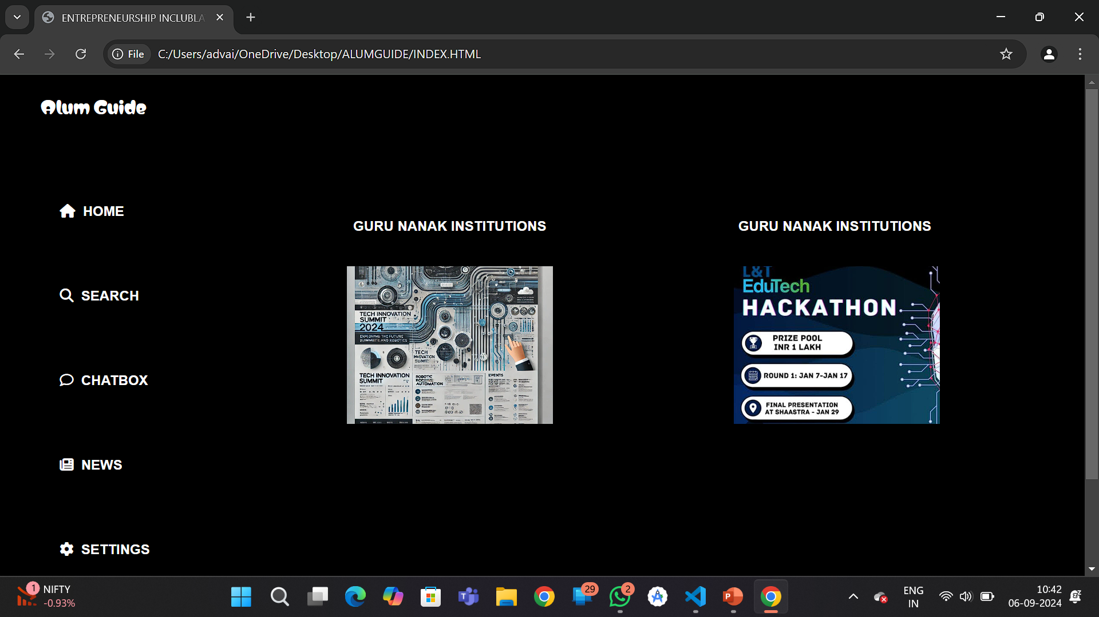

Slide 9
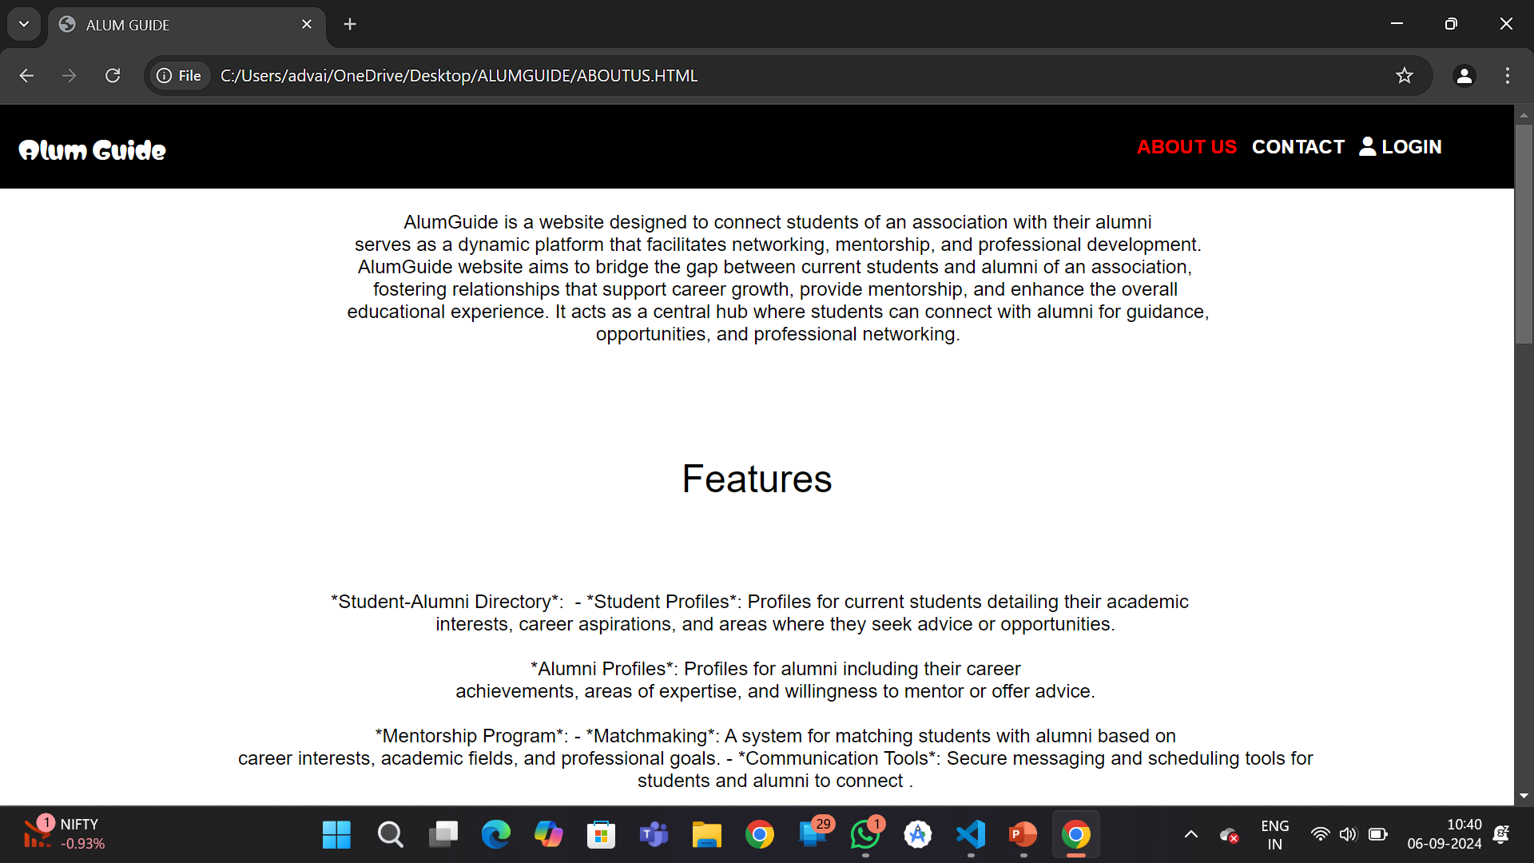

Slide 10
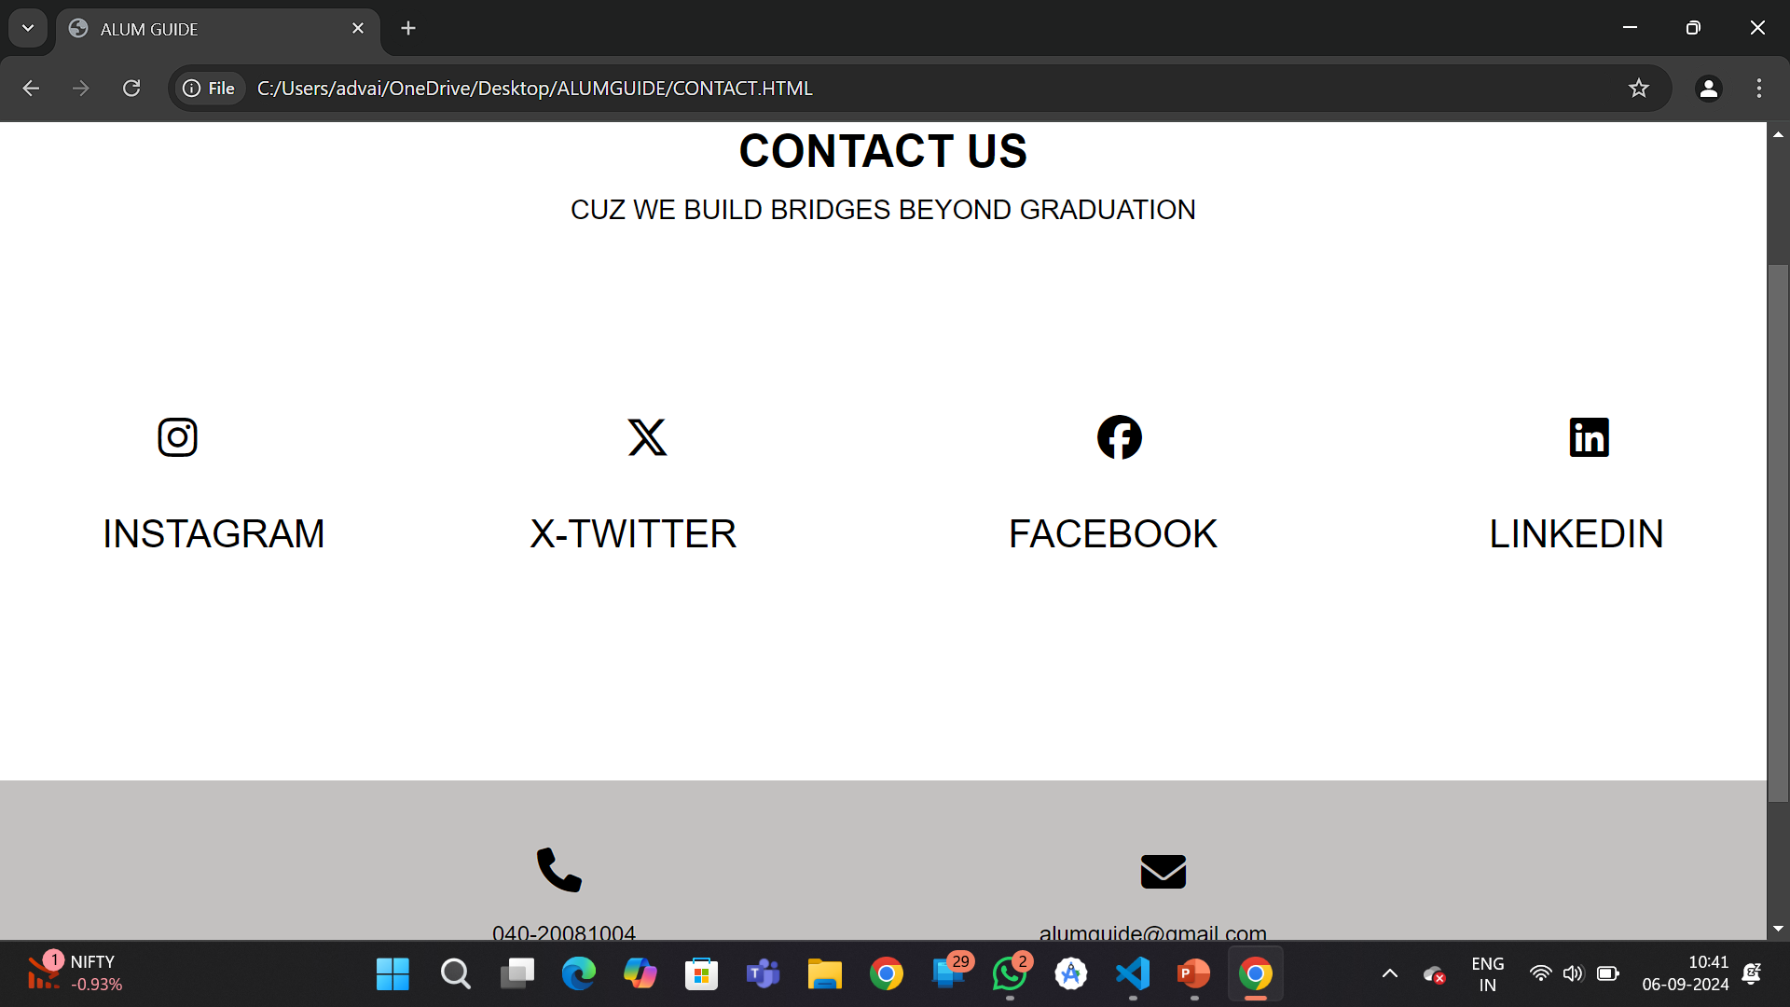

Slide 11
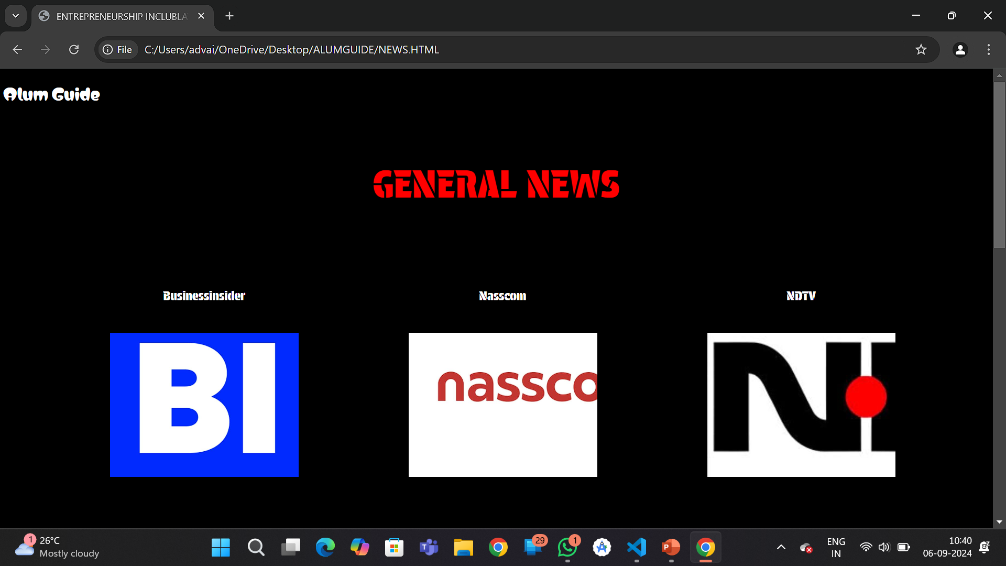

Slide 12
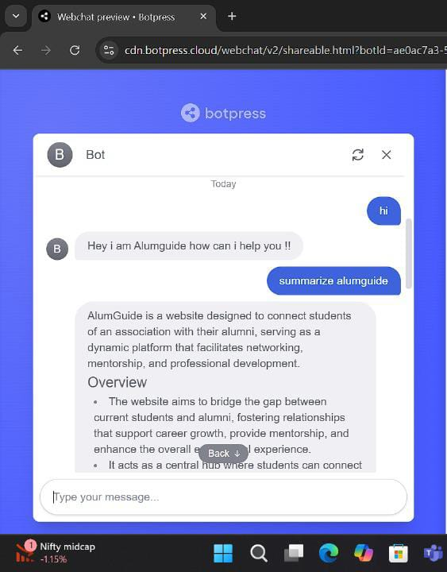

Slide 13
